Slide 1
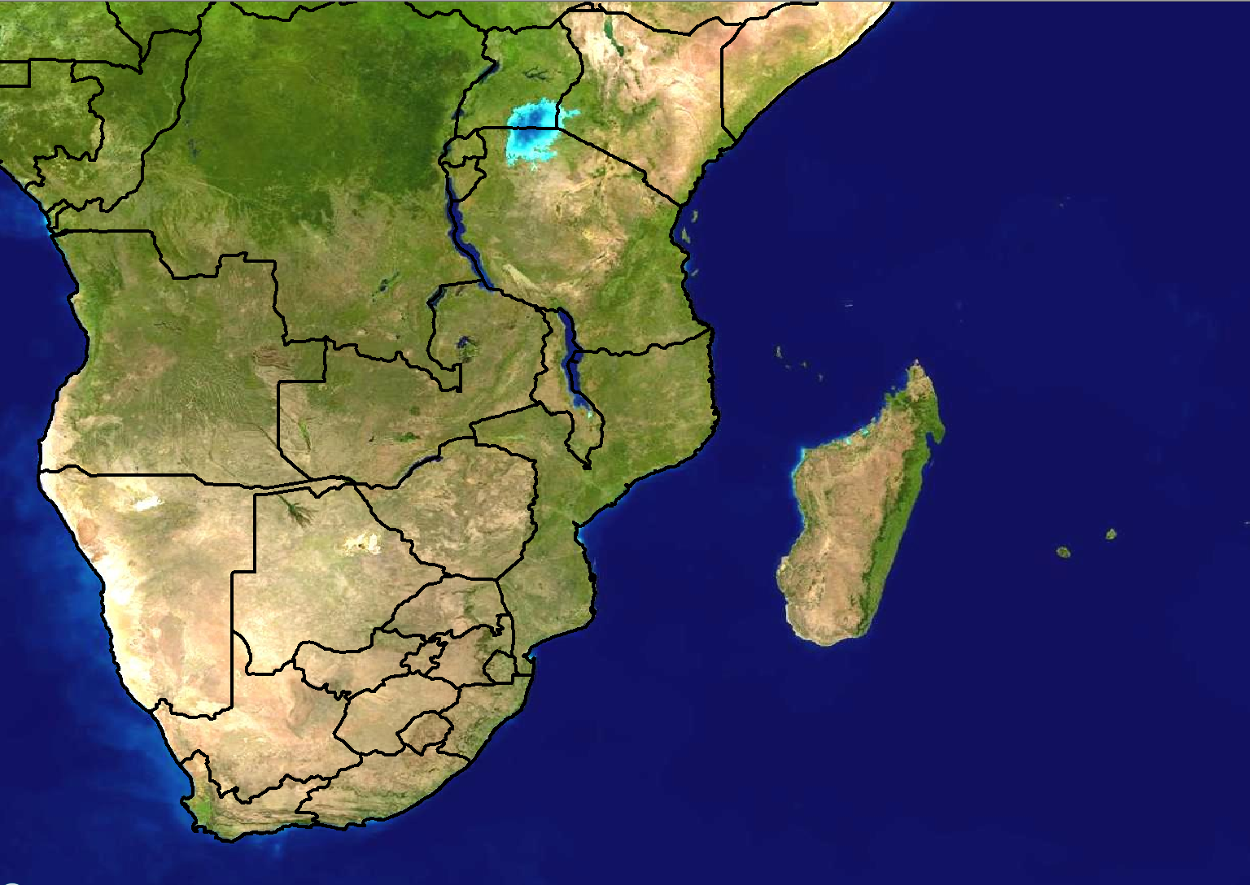
Scenario 1: Forecast for Day 3
24 hour rainfall (mm)
>100
80-100
60-80
40-60
20-40
Forecast issued:
Monday 20 February
Forecast valid:
Wednesday 23 February

Slide 2
Scenario 1 - Additional information:
The ITCZ is currently situated slightly more northwards than what it usually is for this time of year
Models are showing a large area of rainfall expected with high rainfall amounts as shown in the diagram
There has been recent flooding over the southern parts of Malawi as well as the extreme northern parts of Zimbabwe which has caused some panic amongst the general public as many lost their houses in the flood
Rainfall amounts of 80mm occurred within 1 hour in many places, resulting in flash floods that caused low lying bridges to be washed away and areas are now cut-off

Slide 3
Scenario 2: Forecast for Day 1 (Today)
24 hour rainfall (mm)
>100
80-100
60-80
40-60
20-40
Forecast issued:
Wednesday 23 February Forecast valid:
Wednesday 23 February

Slide 4
Scenario 2 - Additional information:
Models have changed quite a bit since Monday with regards to rainfall amounts. There has been a serious increase in these amounts from what was originally expected
There is a lot of agreement from the models about the placing and timing of the rainfall as well as the rainfall amounts
Some members of the media have seen some global model output and this has caused a great deal of further panic for the people that were recently affected by the floods
The media are requesting further information on what is expected and the impacts this rain will have on the saturated land

